Slide 1

The PEO Superstars template is an opportunity for you to feature partners, clients, policymakers, and members of your community who have been champions for your individual PEO or the PEO industry.
The slide shown below is an editable template that allows for changing both the copy and the headshot of the person you want to highlight. Save the slide as a PNG or JPG to post on social.
Note: To edit the headshot, click on the image, navigate to Picture Format, select “Change Picture” and ”From a File,” and select your replacement image. This will replace the picture while maintaining the circular design. If your image appears distorted, select the “Fill” option under the Crop dropdown on the Picture Format page.

Slide 2
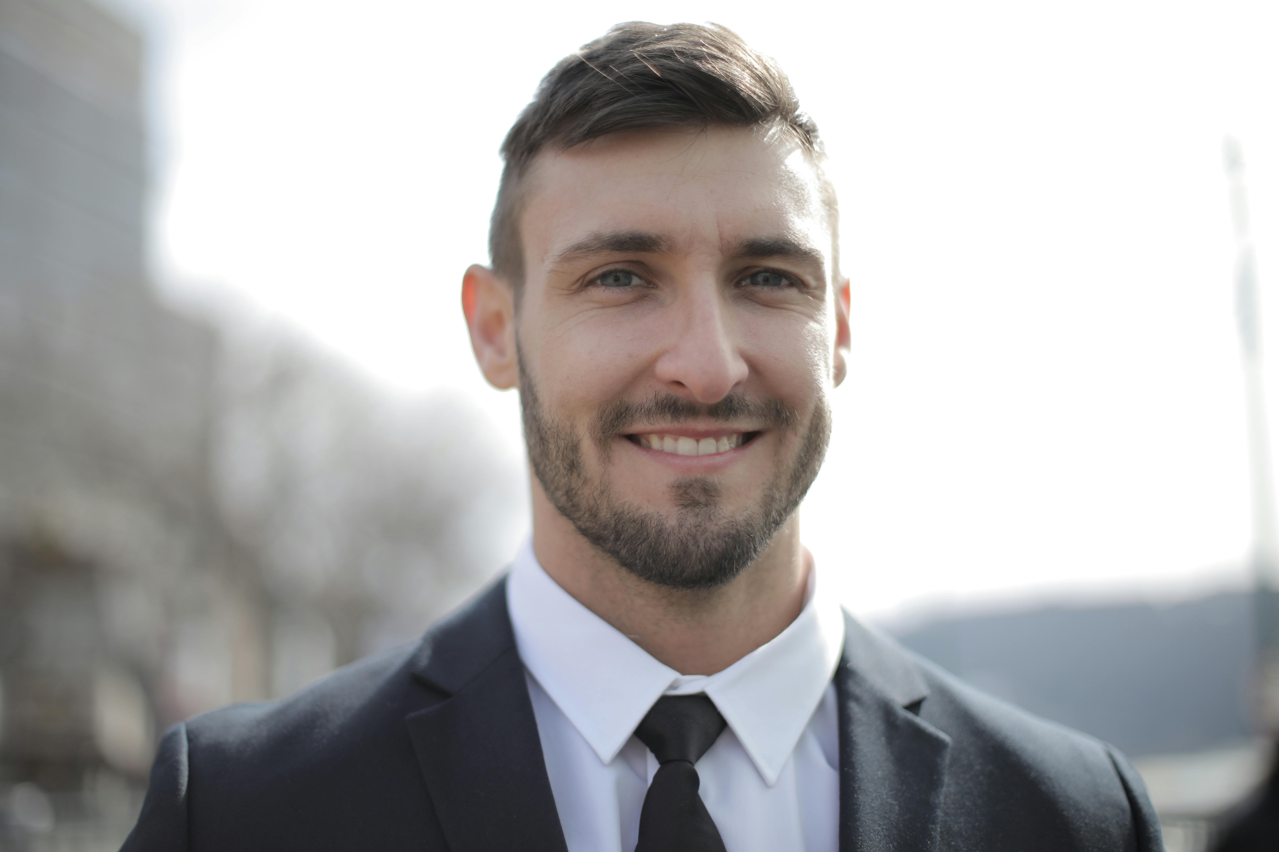





PEO SUPERSTARS
David Kessler III
Customer Division Facilitator - Osinski Group
Volutpat etiam rhoncus sit sed ut duis semper. Diam sit facilisis eu.
Ac pellentesque massa volutpat adipiscing sit egestas urna. Nisi mauris mi.
Nisl libero fermentum sem duis est faucibus.
Enim posuere in odio feugiat in faucibus commodo massa euismod. Hac dignissim lorem scelerisque vitae morbi. Pretium ipsum quisque viverra mauris. Vel venenatis arcu dictum nisi nam. Risus iaculis in duis sed. Nisl nulla fringilla leo vestibulum consectetur pharetra auctor amet sed. Posuere morbi augue enim.”

